Slide 1
OpenStudio Thermal Analysis
Comparison of thermal consumption between Abu Dhabi, Piacenza and Helsinki
Comparison of thermal consumption in Helsinki with different exterior wall materials
Professor: Behzad Najafi
Students:
Zhu Cuiling
Gong Meiling
Wang Rui
Yang Dicheng

Slide 2
CATALOGUE
OpenStudio thermal analysis - Comparisons
1
Building's Characteristics
(Excluding heat transfer and humid air fundamentals. )
-Geometric characteristics
-Main structural points
-materials and U _value of external walls
-Corresponding load component
Base Case Task – building with concrete wall in Helsinki
-Weather information
-Monthly heating and cooling consumption
Parametric Study – different cities (Helsinki, Abu Dhabi and Piacenza)
-Weather information
-Yearly heating and cooling consumption
Parametric Study – different external wall in Helsinki (Concrete, wood and metal)
-Concrete (base case)
-wood
-metal
2
3
4

Slide 3
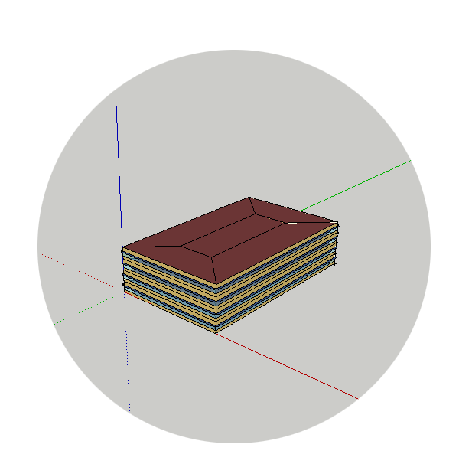
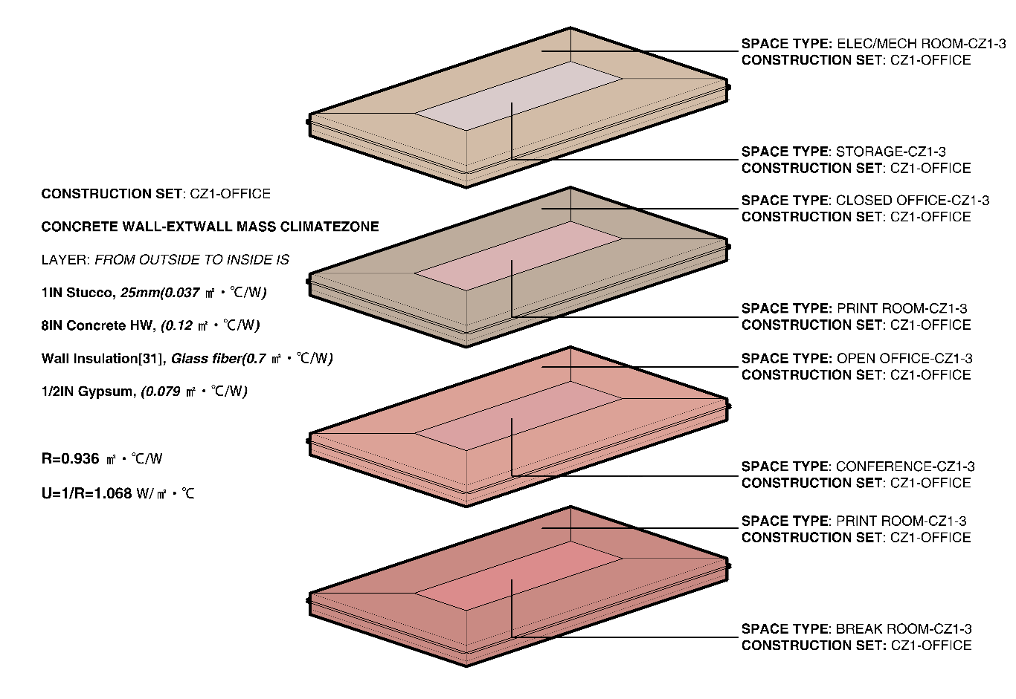
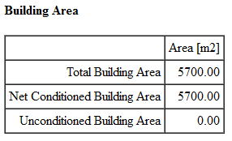
1
Building's Characteristics
Basic model analysis
window
overhang
external wall

Slide 4
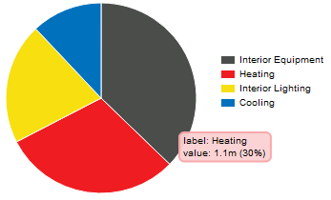
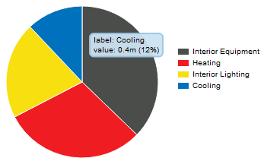
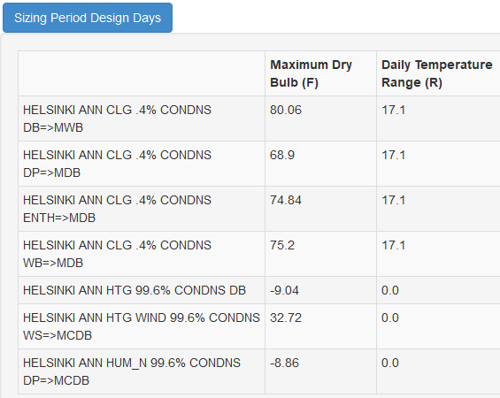
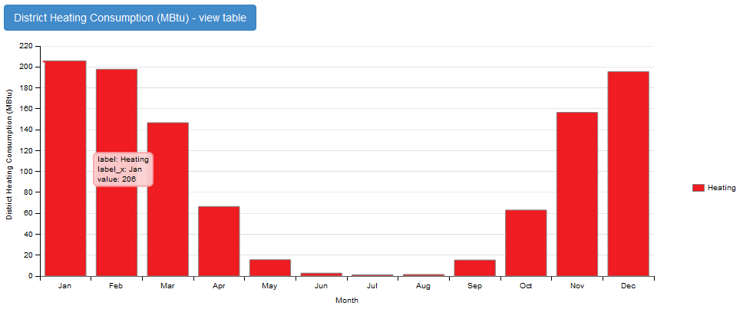
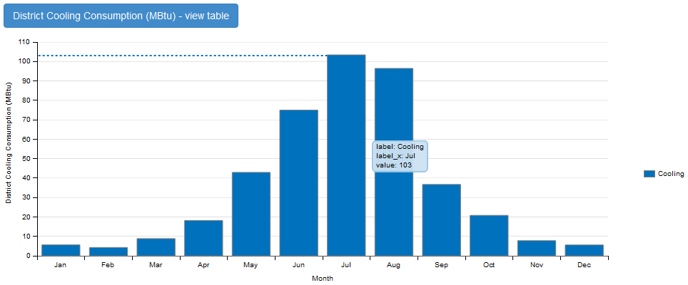
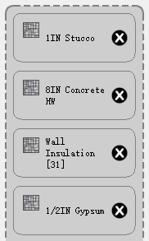
2
Base Case Task
3. Yearly consumption
– Building with concrete wall in Helsinki
1. Weather information
Helsinki (60.32N, 24.97E)
* 1 MBtu＝1055 *10^6 J
4. Monthly consumption
2. Concrete external walls
Layer: | R (㎡·°C/W) | U (W/ ㎡·°C)
1IN Stucco (25mm)
8IN Concrete HW
Wall Insulation [31]
1/2IN Gypsum
SUM | 5.76 | 0.17

Slide 5
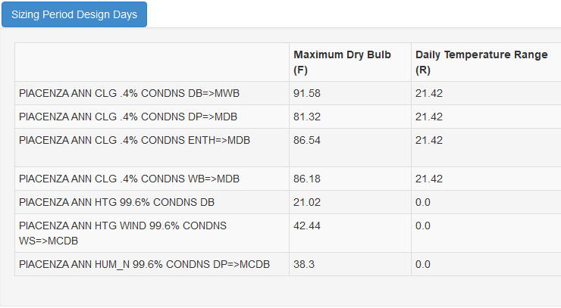
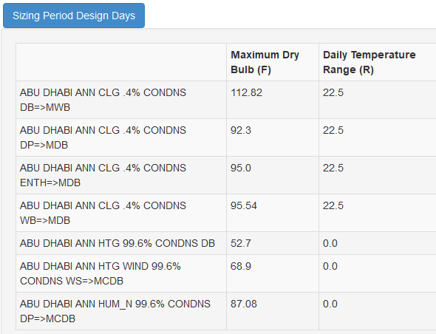
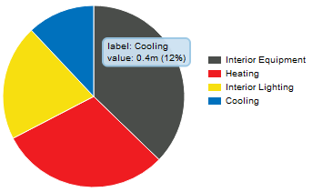
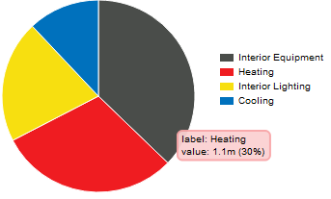
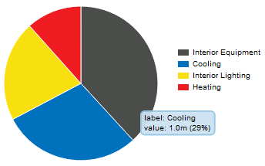
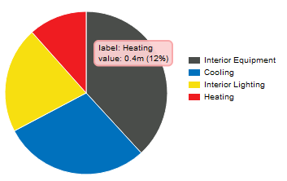
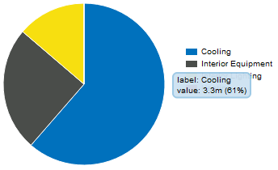
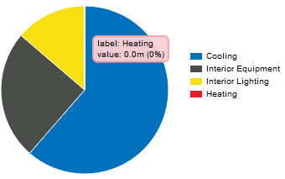
3
Parametric Study – different cities
– Helsinki (base case), Abu Dhabi and Piacenza
1. Comparison of weathers in three cities
Helsinki (60.32N, 24.97E)
Piacenza (44.92N, 9.73E)
Abu Dhabi (24.43N, 54.65E)
2. Comparison of yearly cooling and heating consumption
Yearly End Uses | Helsinki (base case) | Piacenza | Abu Dhabi
Heating DB 99.6% [°C] | -22.8 | -6.2 | 11.5
Cooling DB 0.4% [°C] | 26.7 | 33.1 | 44.9
DR [K] | 17.1 | 11.9 | 22.5
Heating [GJ] | 1127.04 | 423.24 | 0.50
Cooling [GJ] | 449.01 | 1061.42 | 3438.27
* 1 MBtu＝1055 *10^6 J
According to data of this three cities, when Heating DB 99.6% is smaller, heating energy consumption is bigger. When Cooling DB 0.4% is bigger, cooling energy consumption is smaller.

Slide 6
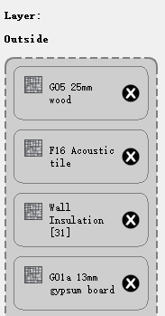
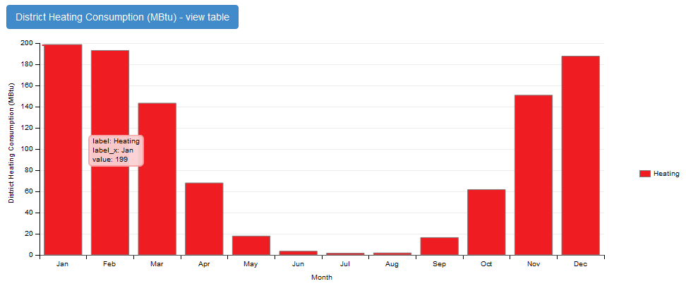
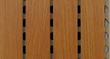
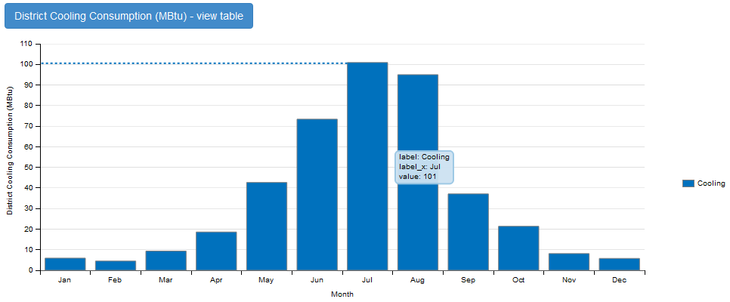
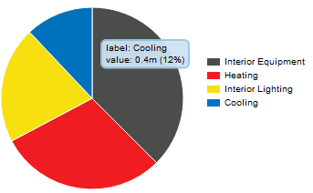
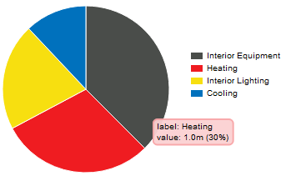
4
Parametric Study – different external wall in Helsinki
– Concrete (base case), wood and metal
1. Wood external walls
1-3. Monthly consumption
Layer: | R (㎡·°C/W) | U (W/ ㎡·°C)
G05 wood (25mm)
F16 Acoustic tile
Wall Insulation [31]
G01a 13mm gypsum board
SUM | 7.66 | 0.13
2-2. Yearly consumption

Slide 7
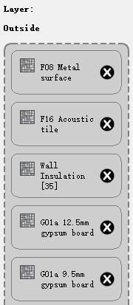
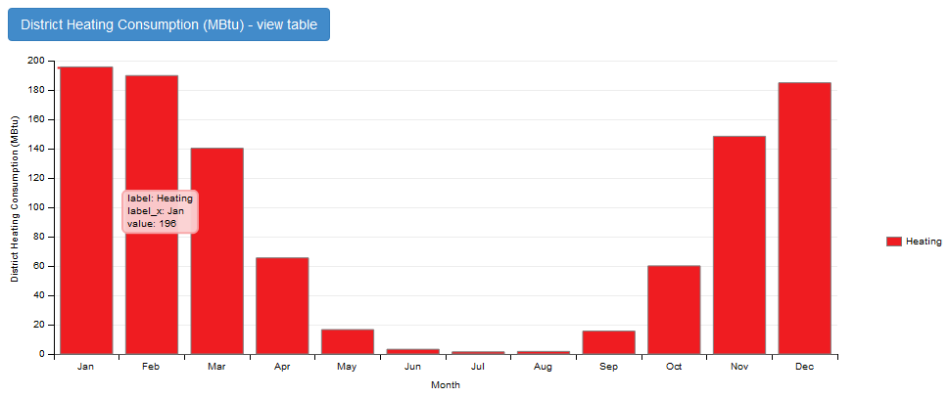

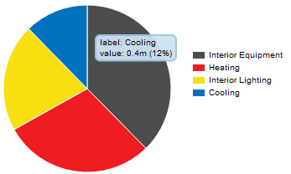
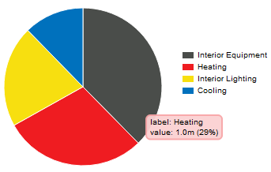
4
Parametric Study – different external wall in Helsinki
– Concrete (base case), wood and metal
2. Metal external walls
2-3. Monthly consumption
Layer: | R (㎡·°C/W) | U (W/ ㎡·°C)
Steel siding
F16 Acoustic tile
Mineral fiber batt (insulation)
Gypsum 12.5mm
Gypsum 9.5mm
SUM | 8.53 | 0.12
2-2. Yearly consumption

Slide 8
4
Parametric Study – different external wall in Helsinki
– Concrete (base case), wood and metal
End Uses | Concrete | Wood | Metal
R_ Value (ft^2*h*R/ Btu) | 5.76 | 7.66 | 8.53
U_ Value (Btu/ ft^2*h*R) | 0.17 | 0.13 | 0.12
Heating [GJ] | 1127.04 | 1101.76 | 1079.78
Cooling [GJ] | 449.01 | 445.90 | 454.40
* 1 GJ is equal to 10^9 J
$$HF=U∗∆T_{heating}$$
$$CF=U∗\left({OF}_{t} ∆T_{cooling}+{OF}_{b}+{OF}_{r}DR\right)$$
The resistance of concrete is smallest of these three types, while that of the metal is biggest.
When the resistance of external wall materials is bigger, The Overall heat transfer coefficient is smaller, so the heating and cooling load are smaller.

Slide 9
Thank you for watching
OpenStudio Thermal Analysis
Professor: Behzad Najafi
Comparison of thermal consumption between Abu Dhabi, Piacenza and Helsinki
Comparison of thermal consumption in Helsinki with different exterior wall materials
Students:
Zhu Cuiling
Gong Meiling
Wang Rui
Yang Dicheng

